Slide 1
QUANTITATIVE RESEARCH
CHARACTERISTICS AND TYPES

Slide 2
General Types of Educational Research
Descriptive — survey, historical, content analysis, qualitative
Associational — correlational, causal-comparative
Intervention — experimental, quasi-experimental, action research (sort of)
This division is irrespective of the quan/qual divide

Slide 3
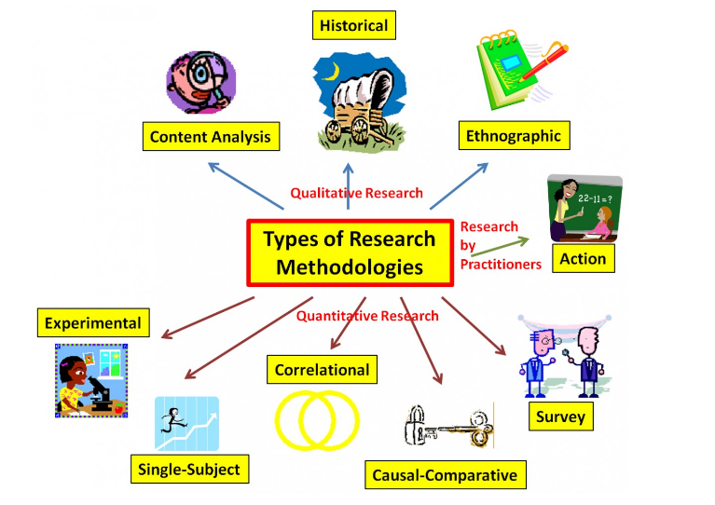

Slide 4
QUANTITATIVE RESEARCH
Quantitative research is the collection and analysis
of numerical data to describe, explain, predict,
or control phenomena of interest.

Slide 5
Quantitative Research
This research operates on the philosophical belief or assumption that we inhabit a
relatively stable, uniform, and coherent world that we can measure, understand, and
generalize about.
This view, adopted from the natural sciences, implies that the world and the laws that
govern it are somewhat predictable and can be understood by scientific research and
examination. In this quantitative perspective, claims about the world are not
considered meaningful unless they can be verified through direct observation.

Slide 6
THE QUANTITATIVE PROCESS
At the outset of a study,
quantitative researchers state the hypotheses to be examined
and specify the research procedures
that will be used to carry out the study.
They also maintain control over contextual factors that
may interfere with the data collection and identify
a sample of participants large enough to provide
statistically meaningful data.

Slide 7
Sampling
The first step in selecting a sample is to define the population to which one wishes to generalize the results of a study
The sample is drawn from the population
-Data is collected from the sample
-Statistics are used to determine how likely the sample results are reflective of the population

Slide 8
A number of different strategies can be used to select a sample. Each of the strategies has strengths and weaknesses.
There are times when the research results from the sample cannot be applied to the population because threats to external validity exist with the study.
The most important aspect of sampling is that the sample represent the population.

Slide 9
SIMPLE RANDOM SAMPLING
Each subject in the population has an equal chance of being selected regardless of what other subjects have or will be selected.
A random number table or computer program is often employed to generate a list of random numbers to use.
A simple procedure is to place the names from the population is a hat and draw out the number of names one wishes to use for a sample.

Slide 10
STRATIFIED RANDOM SAMPLING
– A representative number of subjects from various subgroups is randomly selected.
The subgroups are called strata and the sample drawn from each strata is proportionate to the propsrtions of the strata in the sample
E.g. if a population has 100 teachers (50 elementary, 30 secondary and 2 tertiary), then in a sample of 10, 5 should be from the elementary stratum, 3 from secondary stratum and 2 from the tertiary stratum

Slide 11
CLUSTER SAMPLING
In cluster sampling, intact groups, not individuals,
are randomly selected.
Any location within which
we find an intact group of population members
with similar characteristics is a cluster.
Examples
of clusters are classrooms, schools, city blocks, hospitals,
and department stores.

Slide 12
When is it used?
Cluster sampling is done when the researcher is unable to obtain a list of all members of the population.
It is also convenient when the population is very large or spread over a wide geographic area.
For example, instead of randomly selecting from all fifth graders in a large city, you could randomly select fifth-grade classrooms and include all the students in each classroom. Cluster sampling usually involves less time and expense and is generally more convenient

Slide 13
An extension of the Cluster Random Sample is the
TWO-STAGE CLUSTERE RANDOM SAMPLE.
In this situation, the clusters (classes in our example) are randomly selected and then students within those clusters are randomly selected.

Slide 14
CONVENIENCE SAMPLING
Subjects are selected because they are easily accessible. This is one of the weakest sampling procedures.
An example might be surveying students in one’s class.
Generalization to a population can seldom be made with this procedure.

Slide 15
PURPOSIVE SAMPLING
– Subjects are selected because of some characteristic.
Also referred to as judgment sampling and is the process of selecting a sample that is believed to be representative of a given population.
Sample selection is based on the researcher’s knowledge and experience of the group to be sampled using clear criteria to guide the process.

Slide 16
SYSTEMATIC SAMPLING
– Systematic sampling is an easier procedure than random sampling when you have a large population and the names of the targeted population are available.
Systematic sampling involves selection of every nth (i.e., 5th) subject in the population to be in the sample.
Suppose you had a list of 10,000 voters in your area and you wished to sample 400 voters for research
We divide the number in the population (10,000) by the size of the sample we wish to use (400) and we get the interval we need to use when selecting subjects (25).
In order to select 400 subjects, we need to select every 25th person on the list.

Slide 17
Ethics of Research
Researchers are bound by a code of ethics that includes the following protections for subjects
Protected from physical or psychological harm (including loss of dignity, loss of autonomy, and loss of self-esteem)
Protection of privacy and confidentiality
Protection against unjustifiable deception
The subject must give voluntary informed consent to participate in research. Guardians must give consent for minors to participate. In addition to guardian consent, minors over age 7 (the age may vary) must also give their consent to participate.

Slide 18
Informed Consent
All research participants must give their permission to be part of a study and they must be given pertinent information to make an “informed” consent to participate.
This means you have provided your research participants with everything they need to know about the study to make an “informed” decision about participating in your research. Researchers must obtain a subject’s (and parents’ if the subject is a minor) permission before interacting with the subject or if the subject is the focus of the study.
Generally, this permission is given in writing; however, there are cases where the research participant’s completion of a task (such as a survey) constitutes giving informed consent.

Slide 19
INSTRUMENT
Instrument is the generic term that researchers use for a measurement device (survey, test, questionnaire, etc.).
To help distinguish between instrument and instrumentation, consider that the instrument is the device and instrumentation is the course of action (the process of developing, testing, and using the device).

Slide 20
Instruments fall into two broad categories,
researcher-completed and subject-completed,
distinguished by those instruments that researchers administer versus those that are completed by participants. Researchers chose which type of instrument, or instruments, to use based on the research question.

Slide 21
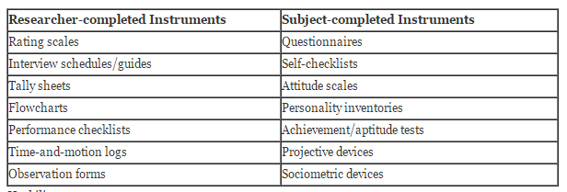

Slide 22
Usability
Usability refers to the ease with which an instrument can be administered, interpreted by the participant, and scored/interpreted by the researcher.
Example usability problems include:
Students are asked to rate a lesson immediately after class, but there are only a few minutes before the next class begins (problem with administration).
Students are asked to keep self-checklists of their after school activities, but the directions are complicated and the item descriptions confusing (problem with interpretation).

Slide 23
VALIDITY
Validity is the extent to which an instrument measures what it is supposed to measure and performs as it is designed to perform.
It is rare, if nearly impossible, that an instrument be 100% valid, so validity is generally measured in degrees.
There are numerous statistical tests and measures to assess the validity of quantitative instruments, which generally involves pilot testing.

Slide 24
External validity is the extent to which the results of a study can be generalized from a sample to a population. Establishing eternal validity for an instrument, depends directly on sampling.
An instrument that is externally valid helps obtain population generalizability, or the degree to which a sample represents the population.
Content validity refers to the appropriateness of the content of an instrument. In other words, do the measures (questions, observation logs, etc.) accurately assess what you want to know?
This is particularly important with achievement tests.

Slide 25
RELIABILITY
A test is reliable to the extent that whatever it measures, it measures it consistently.
Does the instrument consistently measure what it is intended to measure?
There are 4 estimators to gauge reliability:
Inter-Rater/Observer Reliability: The degree to which different raters/observers give consistent answers or estimates.
Test-Retest Reliability: The consistency of a measure evaluated over time.
Parallel-Forms Reliability: The reliability of two tests constructed the same way, from the same content.
Internal Consistency Reliability: The consistency of results across items.

Slide 26
NOW LET’S STUDY DIFFERENT QUANTITATIVE METHODS

Slide 27

Descriptive Research/Survey Research

Slide 28
Definition:
Descriptive research involves collecting data to test hypotheses or to answer questions about people’s opinions on some topic or issue.
Survey is in an instrument to collect data that describes one or more characteristics of a specific population.
Survey data are collected by asking members of population a set of questions via a Questionnaire or an Interview.
Descriptive research requires attention to the selection of an adequate sample and an appropriate instrument.

Slide 29
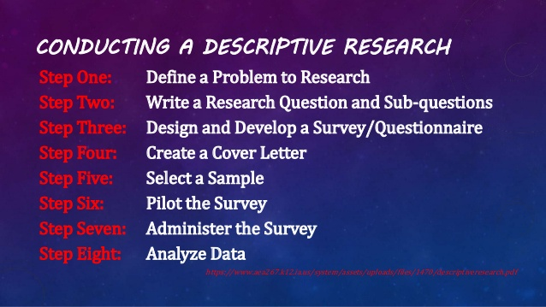

Slide 30
Rsearch Design
Survey can be categorized as
Cross-sectional
point in time Collects data at one
Longitudinal
Collects data at more than one time to measure growth or change

Slide 31
Conducting Descriptive Research
It requires a collection of standardized quantifiable information from all members of a population or sample .
Questionnaire
Is a written collection of self report questions to be answered by selected group of research participants.
Interview
Is an oral ,in-person question and answer session between a researcher and individual respondent.

Slide 32
Constructing The Questionnaire
A Questionnaire should be attractive ,brief and easy to respond .
No item should be included that does not directly relate to the objective of the study.
Structured or closed ended should be used.
Common structured items used in questionnaire are scaled items , ranked items and checklists.
In an Unstructured item format respondents have complete freedom of response but often are difficult to analyze and interpret.

Slide 33
Each question should focus on :
Single concept
Clear wording
Terms and meaning should be defined.
Questionnaire should begin with general,
Non threatening questions.
Avoid leading questions

Slide 34
Pilot Testing
The questionnaire should be tested by respondent who are similar to those in the sample of the study.
Pilot testing provides information about deficiencies as well as suggestions for improvement.
Omission or unclear or irrelevant items should be revised.
Pilot testing or review by colleagues can provide a measure of content validity.

Slide 35
Cover Letter
Every mailed or Emailed questionnaire must be accompanied by cover letter that explains What is being asked and why is being asked.
The cover letter should be brief, neat and addressed to the specific individual.

Slide 36

Selecting Participants
Participants should be selected using an appropriate sampling technique.
The researcher should ensure that the identified participants should have the desired information and must be willing to share it .

Slide 37
Distributing the Questionnaire
Questionnaires are usually distributed via one of five approaches:
mail
email
telephone
Personal administration
interview

Slide 38


Slide 39
Tabulating Questionnaireresponses
The simplest way to present the result is to indicate the percentage of respondents who selected each alternative for each item.
However analyzing summed items clusters-groups items focused on the same issues is more useful , meaningful and reliable.
Comparison can be investigated in the collected data by examining the responses of different sub-groups in the sample (male/female).

Slide 40

Results

